Slide 1
Fourier Series

Slide 2
1. Introduction
It is convenient to choose a set of orthogonal waveforms as the basic signals.
Why?
  It is mathematically convenient to represent an arbitrary signal as a weighted sum of orthogonal waveforms, since many of the calculations involving signals are simplified by using such a representation.
  It is possible to visualize the signal as a vector in an orthogonal coordinate system, with the orthogonal waveforms being coordinates.
  Representation in terms of orthogonal basis functions provides a convenient means of solving for the representation of an arbitrary signal over a finite interval in terms of some set of orthogonal basis functions.
We learn how to decompose periodic signals into their frequency components.

Slide 3
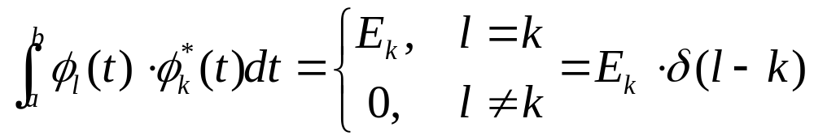

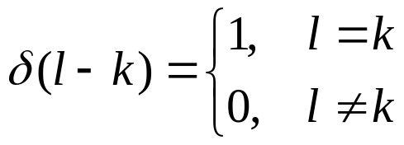
2. Orthogonal Representations of Signals
A set of signals is orthogonal over an interval (a, b)
: complex conjugate
E_{k} : energy dissipated
If E_{k} =1, Φ_{i}(t) is orthonormal

Slide 4

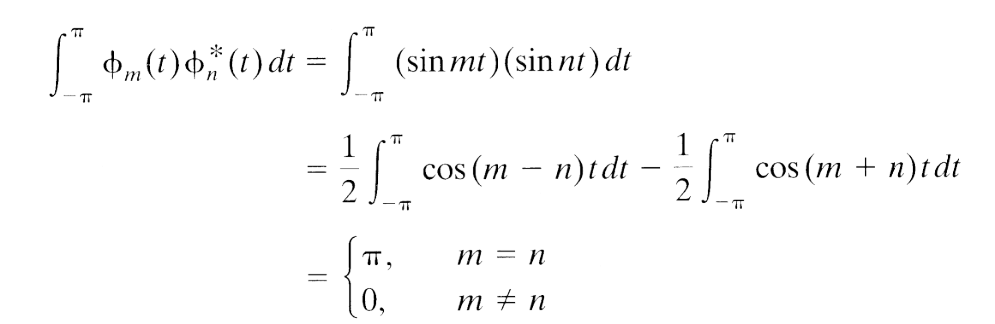
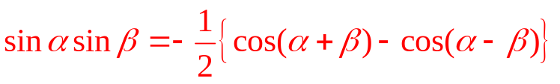
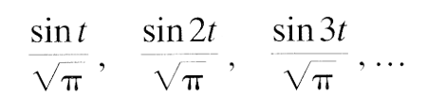
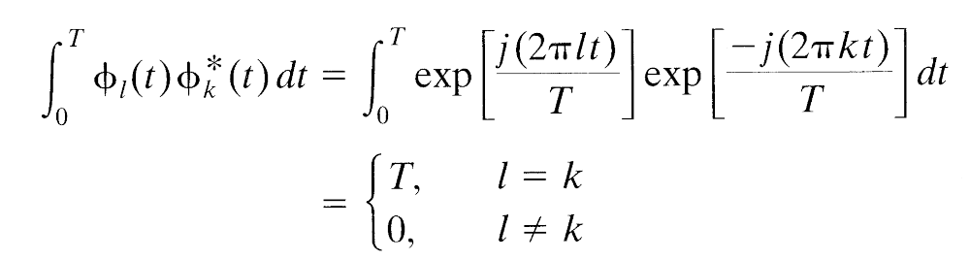
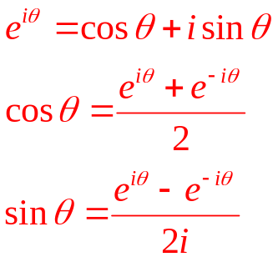

2. Orthogonal Representations of Signals
: Orthonormal set
오일러 공식
: Orthonormal set

Slide 5
2. Orthogonal Representations of Signals
φ₁(t)
φ₂(t)
φ₃(t)
1
1
1
1
2
3
t
1
2
3
t
1
2
3
t
-1
-1
-1

Slide 6
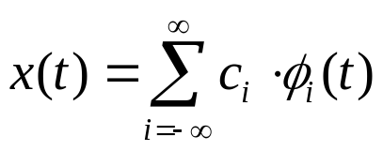
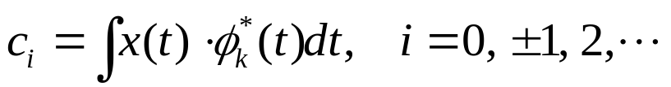
2. Orthogonal Representations of Signals
If Φ_{i}(t) is orthonormal set of signals,
x(t) can be represented in terms of {Φ_{i}(t) }.

Slide 7
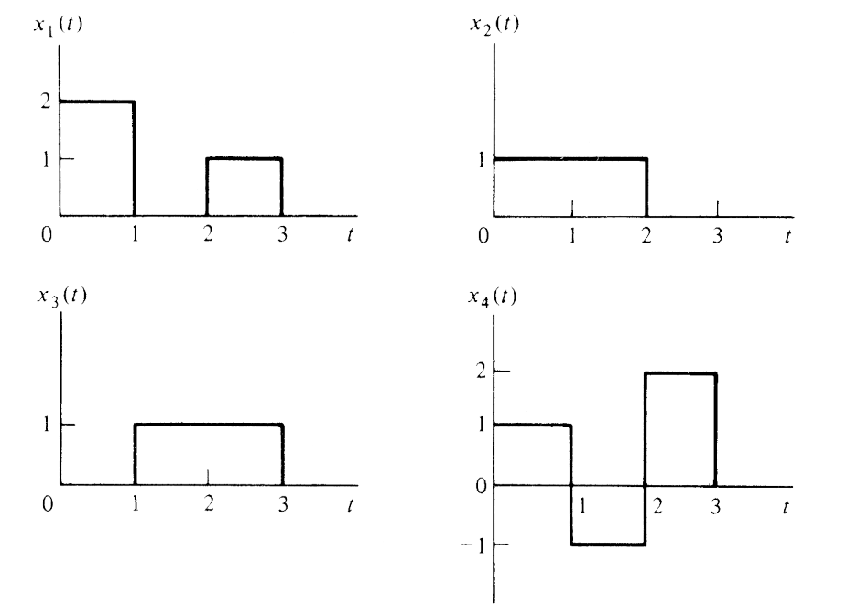
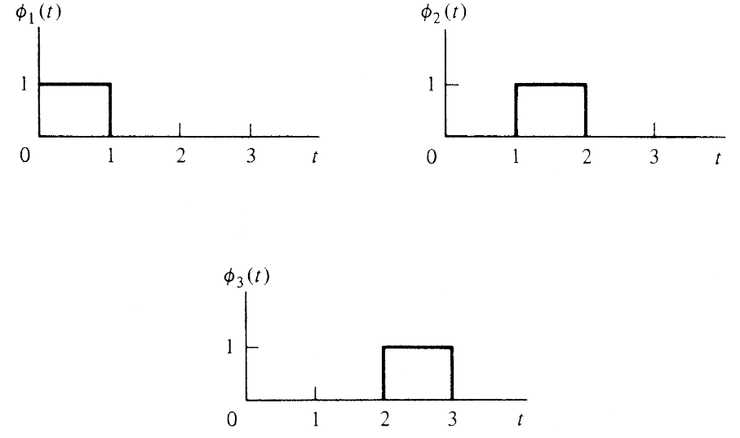
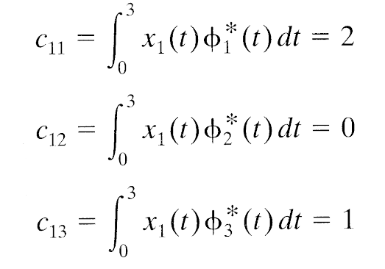

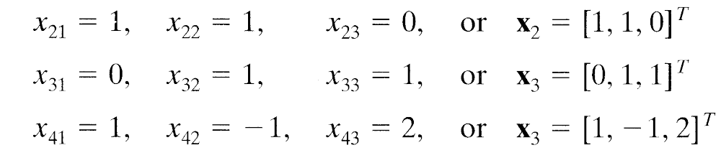
2. Orthogonal Representations of Signals
c₂₁
c₂₂
c₂₃
c₃₁
c₃₂
c₃₃
c₄₁
c₄₂
c₄₃
4

Slide 8
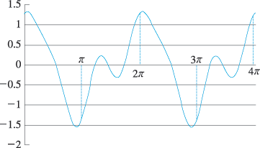
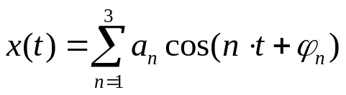
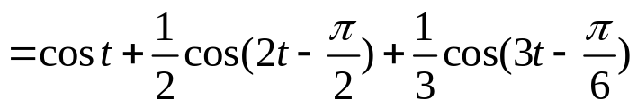
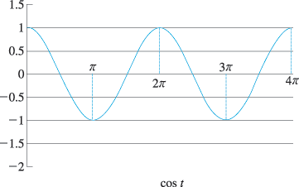
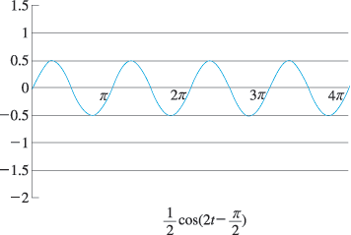
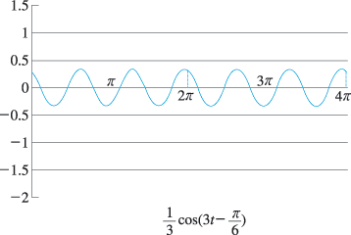
3. The Exponential Fourier Series
푸리에 급수 : 주기함수는 그 주파수의 정수배가 되는 사인파들을 크기와 위상을 적절히 조절하여 더함으로써 합성 가능
응용 분야 : 주파수 특성 분석, 입력된 주기함수에 대한 시스템의 출력을 구함

Slide 9
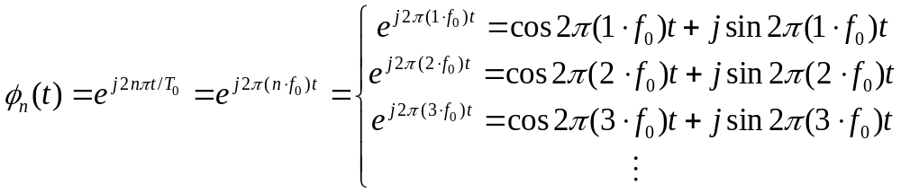
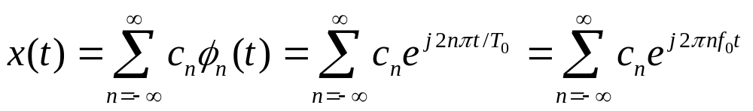
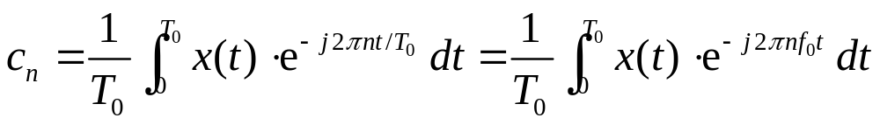
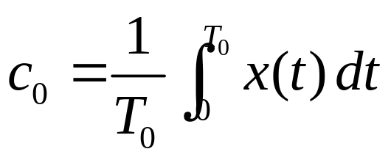
3. The Exponential Fourier Series
Basis function

Slide 10

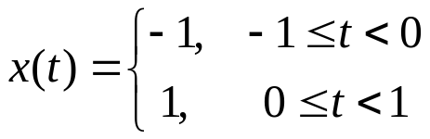

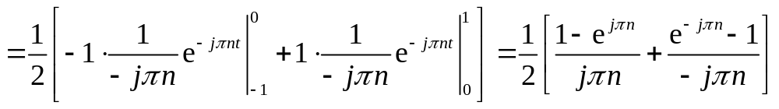
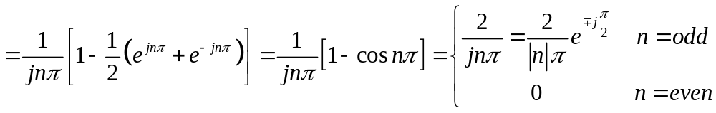
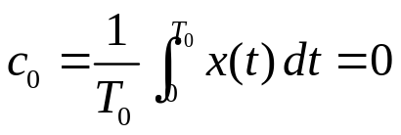
3. The Exponential Fourier Series

Slide 11

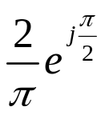
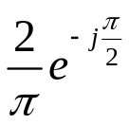
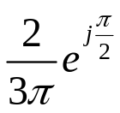
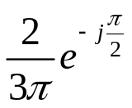
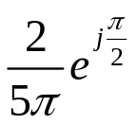
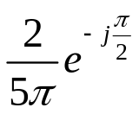

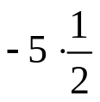
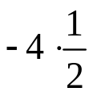
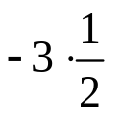
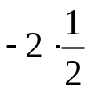
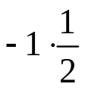





3. The Exponential Fourier Series

Slide 12
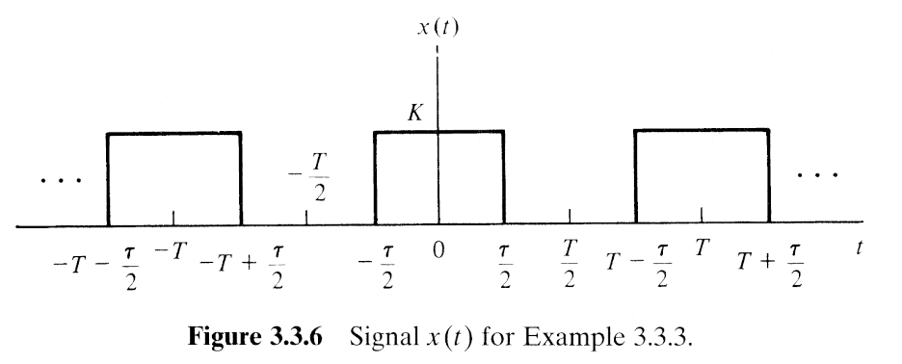
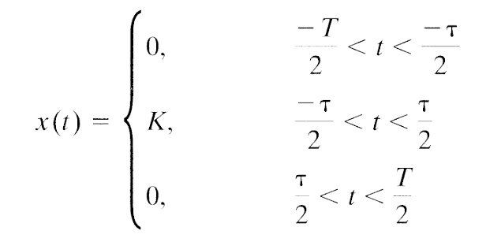
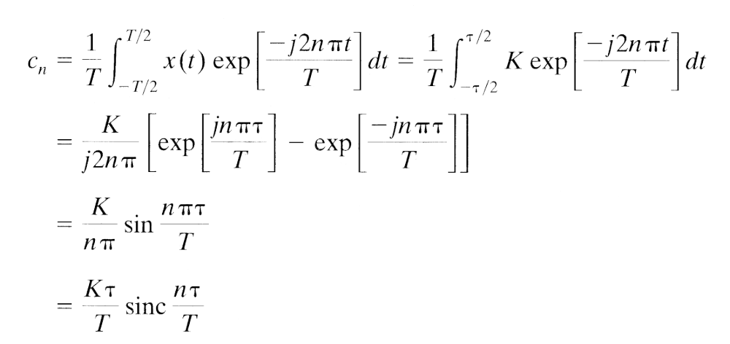
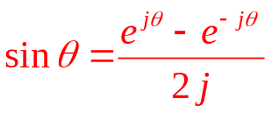
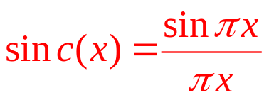
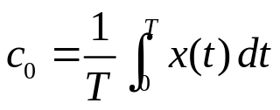
3. The Exponential Fourier Series
1
1,
1
1
1

Slide 13
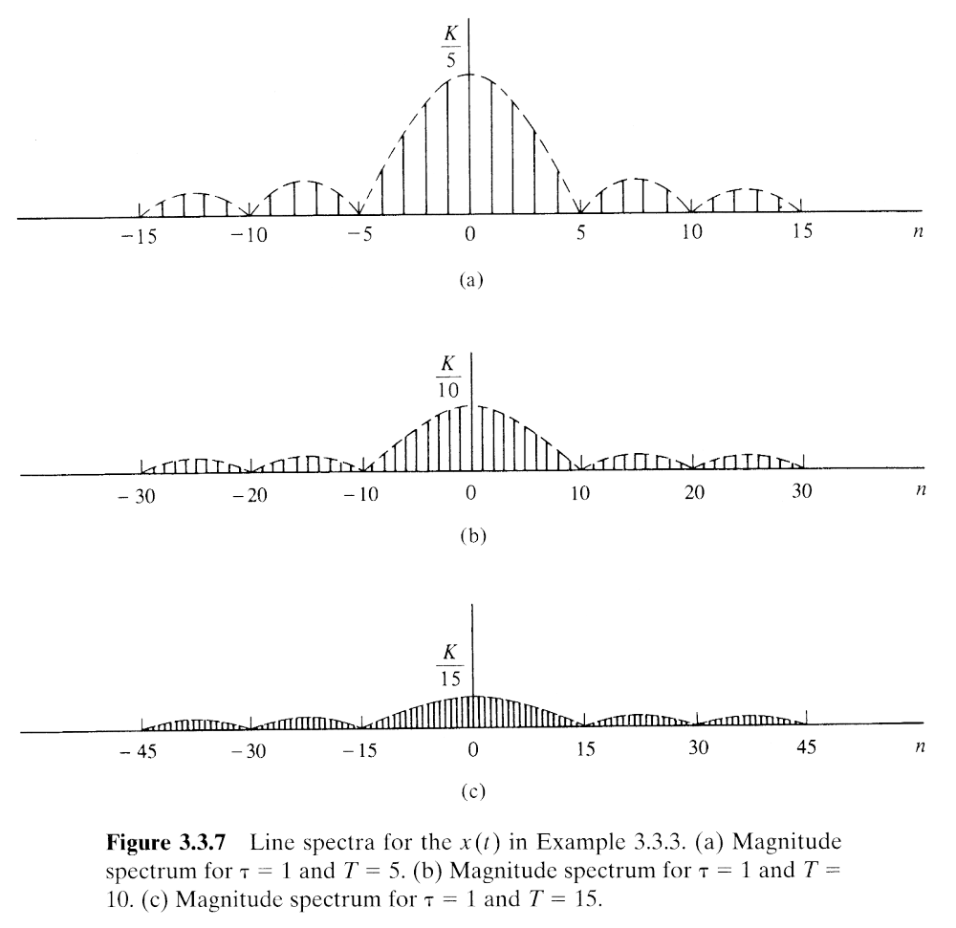







3. The Exponential Fourier Series
if) τ = 1
T 를 증가시킨다면?
T=5
0
f(Hz)
T=10
0
f(Hz)
T=15
0
f(Hz)

